Slide 1



MATHEMATICAL
MODELLING
(21HS61A)
Experiential Learning Presentation On
Mathematical model that accurately simulates the spread of epidemic scale deceases.
Faculty Coordinator
Dr. Venugopal K
Assistant Professor
JAGADEESH ANIRUDH BHAT ARYAN JAIN | (1RV21AS022) (1RV21CH005) (1RV21CH006)

Slide 2
CONTENTS
Introduction
Literature Review
Problem Statement
Epidemic Model ( SIR)
SIR Equations
SIR Application
SIR Variants.
Key Insights and Future Scope
Conclusion

Slide 3
Introduction
The convergence of quantum computing and biomolecular research is opening new frontiers in computational science. Quantum algorithms promise to solve problems intractable for classical computers, while biomolecular algorithms enhance our ability to model and understand biological processes. Together, these advancements are poised to revolutionize fields ranging from drug discovery to personalized medicine. In this presentation we will be showing the specific application of mathematical modelling for the pandemic virus COVID-19 and how useful the model would have been to counteract against it for human beings.
The COVID-19 pandemic has underscored the importance of effective disease modeling. Mathematical models have been essential in predicting the spread of the virus, assessing the impact of public health interventions, and guiding policy decisions. By simulating different scenarios, these models help us make informed choices to mitigate the spread of infectious diseases.

Slide 4
Literature Review
Biomolecular and quantum algorithms for the dominating set problem in arbitrary networks
Authors- Renata Wong, Weng‑Long Chang, Wen‑Yu Chung & Athanasios V. Vasilakos
The document discusses a quantum algorithm proposed for solving the dominating set problem in arbitrary networks.
​ Here is a summary of the key points covered in the document:
Introduction to Dominating Sets:
Dominating sets are crucial for network organization, especially in wireless ad hoc and sensor networks.
They help in energy conservation and efficient control of network behavior.
Proposed Quantum Algorithm:
A quantum algorithm is introduced to solve the dominating set problem with a quadratic speedup over classical algorithms.
The algorithm can be executed on IBM Quantum's simulator and Brooklyn superconducting quantum device.

Slide 5
Literature Review
Mathematical Representation of Molecular Solutions:
Molecular solutions for the dominating set problem are represented in a finite-dimensional Hilbert space.
The process of representing solutions using unit vectors is explained.
Complexity Assessment:
The time and space complexity of the quantum algorithm for the dominating set problem is analyzed.
Experimental Implementation:
The proposed quantum algorithm is implemented for a graph with three vertices and two edges on IBM's simulator and Brooklyn backend.
Results show the effectiveness of the algorithm despite limitations on current quantum devices.

Slide 6
Literature Review
2. COVID-19 SIR model overview
Author- Tawfeek Mohamed Varusai
This document talks about the various types of models that can be used to mathematically represent how an epidemic functions in humans depending upon the current conditions of the species facing the epidemic, and few of them are Stochastic modelling, compartmental modelling, while mainly focusing on SIR modelling for COVID-19, SARC and even herd immunity analysis against the deceases. Setting the parameters and variables to determine the potential functioning or effects of the epidemic on the human species.

Slide 7
Problem Statement
Develop a hybrid computational approach to optimize pandemic response and recovery. Combine SIR models with quantum algorithms to find the best strategies for vaccination, testing, and contact tracing. This will help minimize long-term damage and ensure a quick return to normal. The solutions generated can be applied to a wide range of crisis scenarios, including natural disasters, public health emergencies, and supply chain disruptions.
MATLAB Problem Statement
A city initially has 10,000 people, all of whom are susceptible. Then, a single infectious
individual enters the city at t = 0. Use the following estimates for the parameters:
a = 0.002/7 (1/(personday))
r = 0.15/day
a) Perform the population balances for the I and R state variables to obtain a
complete description of the epidemic model.
b) Verify the units of a and r.
c) Compute the progression of the epidemic via ode45().
d) Physically interpret your results.

Slide 8
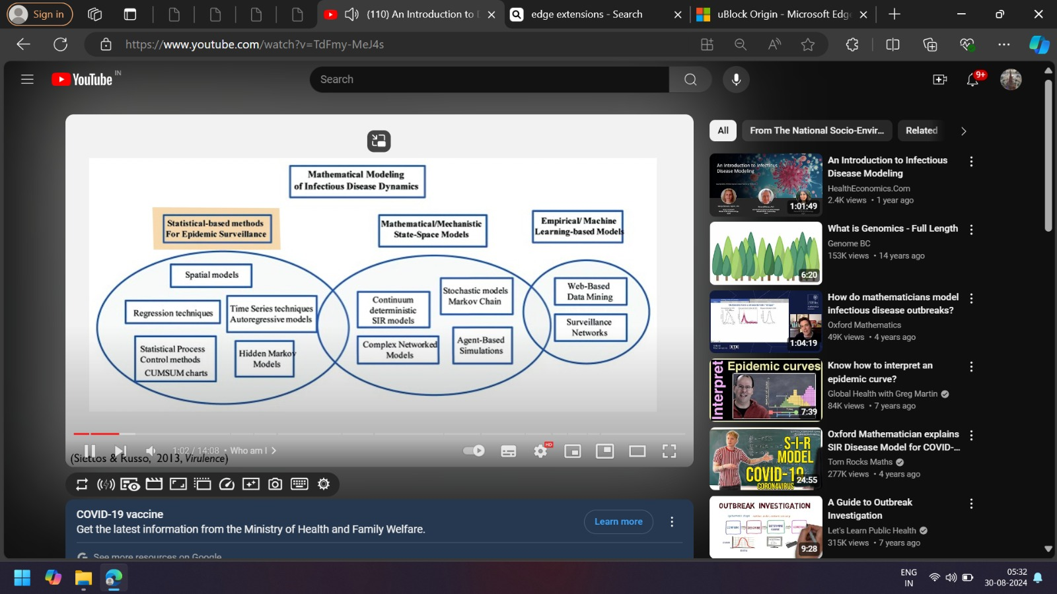
Introduction to Epidemic Models
What are Epidemic Models?
Epidemic models are mathematical frameworks used to describe the spread of infectious diseases within a population.
These models help predict how diseases spread, how long an outbreak might last, how many people might be infected, and what interventions could be effective in controlling the spread.
Types of Epidemic Models:
SIR Model
Stochastic Models
Complex Networked Models
Agent Based Solutions

Slide 9
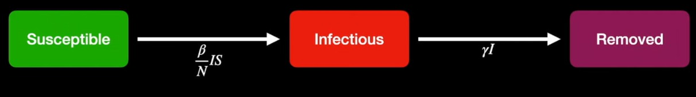
SIR MODEL
The SIR model is one of the most widely used mathematical models in epidemiology to describe the spread of infectious diseases. It divides the population into three categories (or compartments):
S = Susceptible: Individuals who have not yet contracted the disease but are at risk of being infected.
I = Infected: Individuals who currently have the disease and can transmit it to others.
R = Recovered: Individuals who have recovered from the disease and are now immune, meaning they can no longer be infected or transmit the disease.
Basic Structure of SIR model
The SIR model is a set of differential equations that describe how the numbers of susceptible, infected, and recovered individuals change over time.
Assumptions
•Single, closed population
•Constant population size
Instantaneously mixed population, with constant contact rate
•No social structure variation (like age)
•Fixed, uniform infectious period
•Permanent immunity (no reinfection)
•No latency period
•No mutations or other ways for the disease to spread

Slide 10
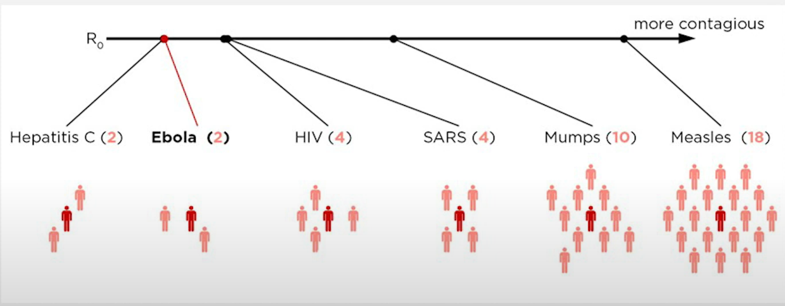
SIR MODEL
Key Parameters:
Transmission Rate (β): The rate at which the disease is transmitted from an infected person to a susceptible person.
Recovery Rate (γ): The rate at which infected individuals recover from the disease and become immune.
Basic Reproduction Number (R0):
The basic reproduction number, R0, is a crucial concept in SIR models. It represents the average number of secondary infections produced by a single infected individual in a completely susceptible population. It is given by the formula:
R0= β/γ
R0 > 1: The disease will spread and potentially lead to an epidemic.
R0 < 1: The disease will eventually die out.

Slide 11
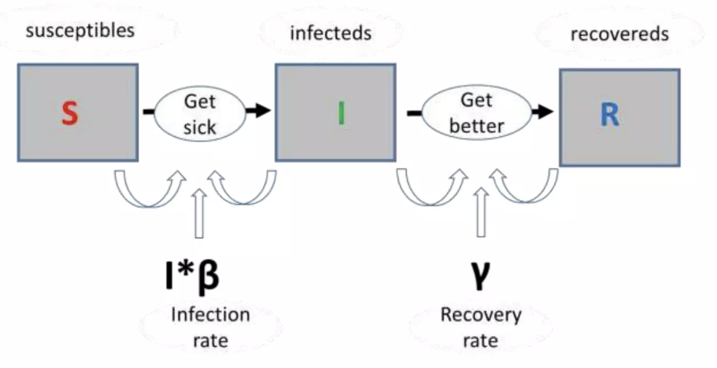
SIR MODEL EQUATIONS
Differential Equations of the SIR Model:
dS/dt = -βSI
This represents the rate of change of the susceptible population. The term βSI shows how new infections reduce the number of susceptible individuals.
β is the transmission rate, representing how frequently susceptible individuals come into contact with infected individuals.
dI/dt = βSI - γI
This equation shows how the number of infected individuals changes over time. New infections increase the infected population, while recoveries reduce it.
γ is the recovery rate, representing the fraction of infected individuals who recover per unit of time.
dR/dt = γI
This describes how the recovered population grows as infected individuals recover.

Slide 12
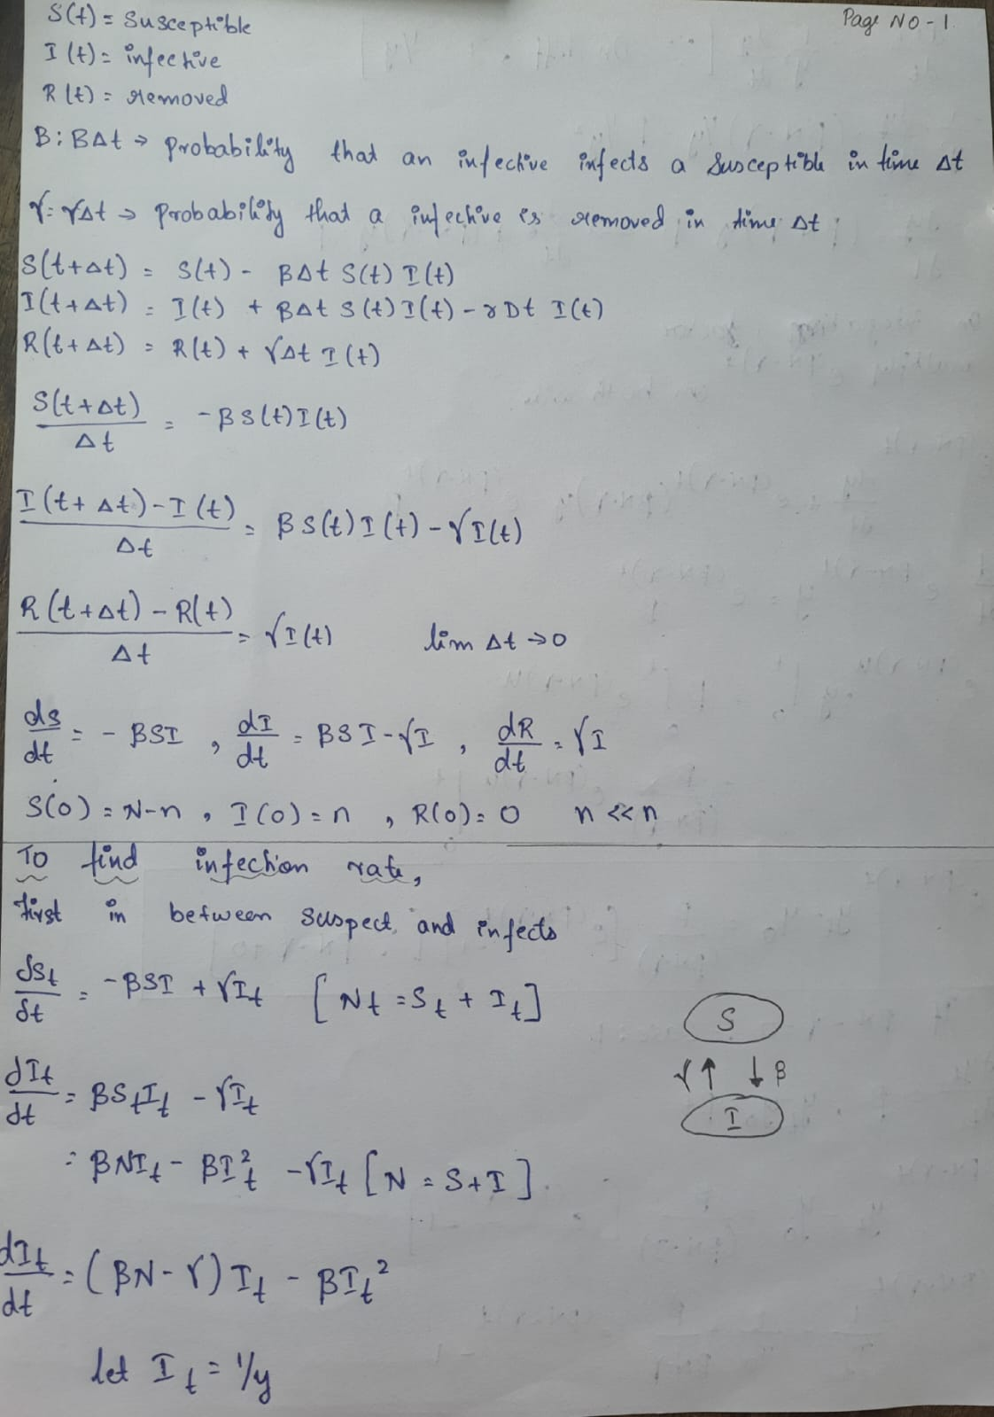
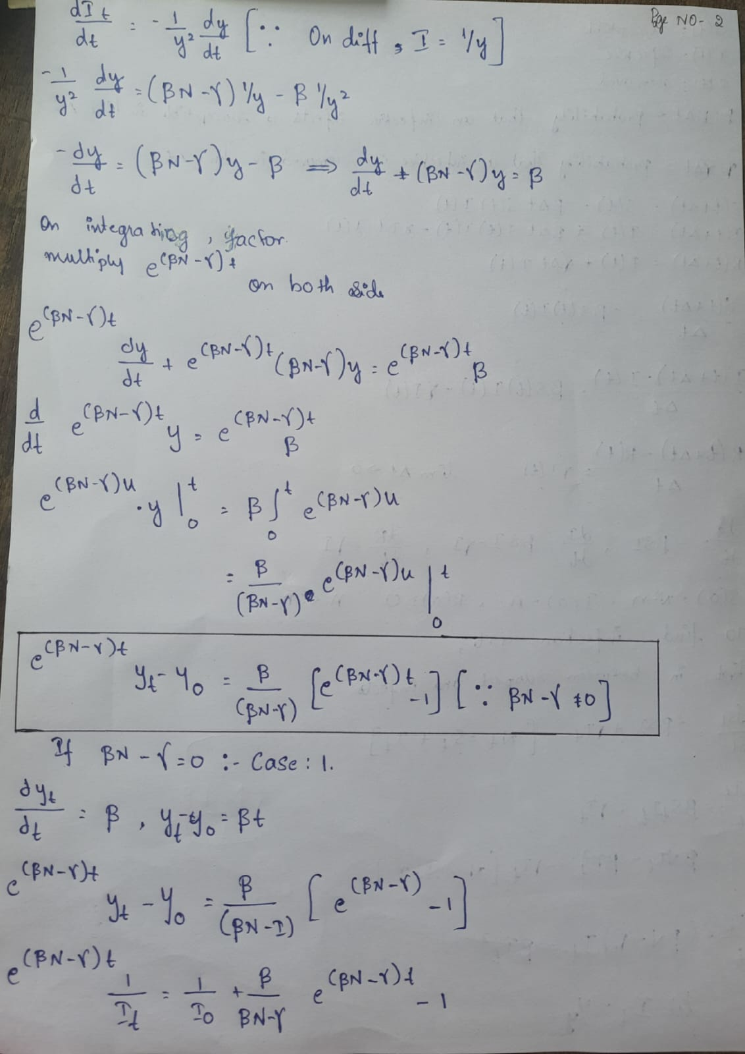
SIR Model Equations

Slide 13
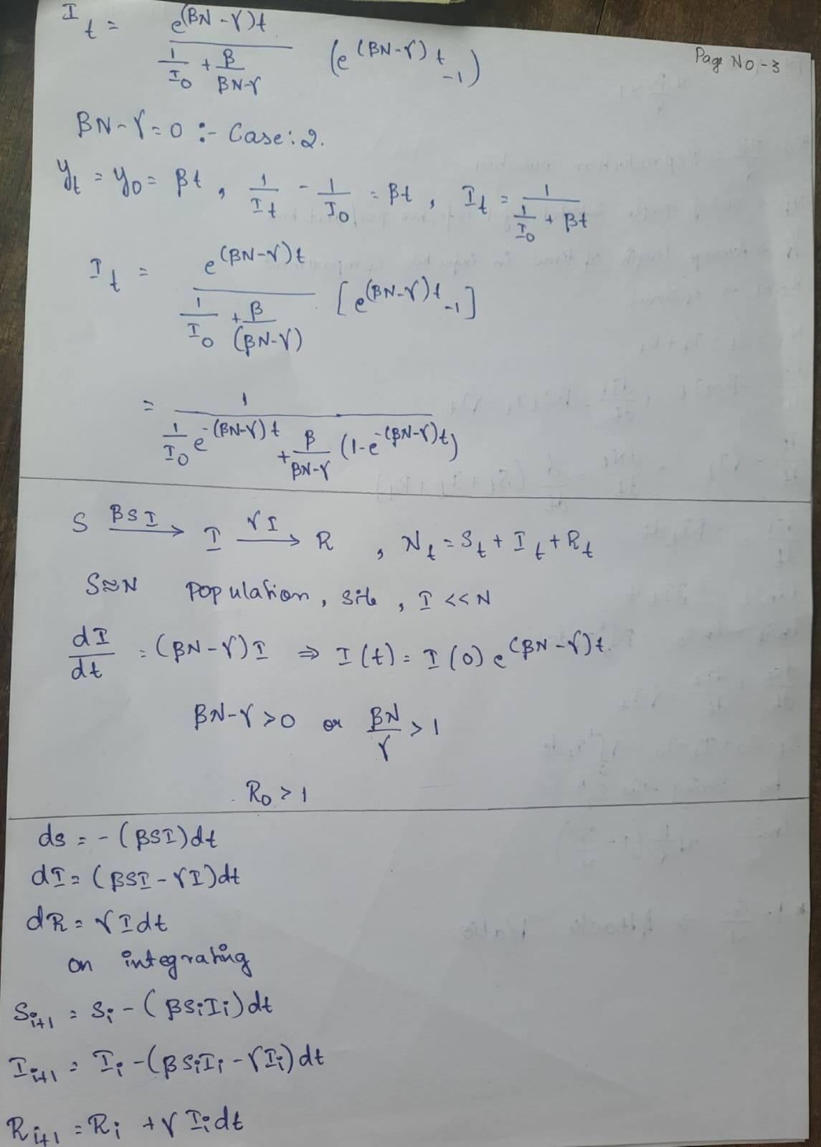
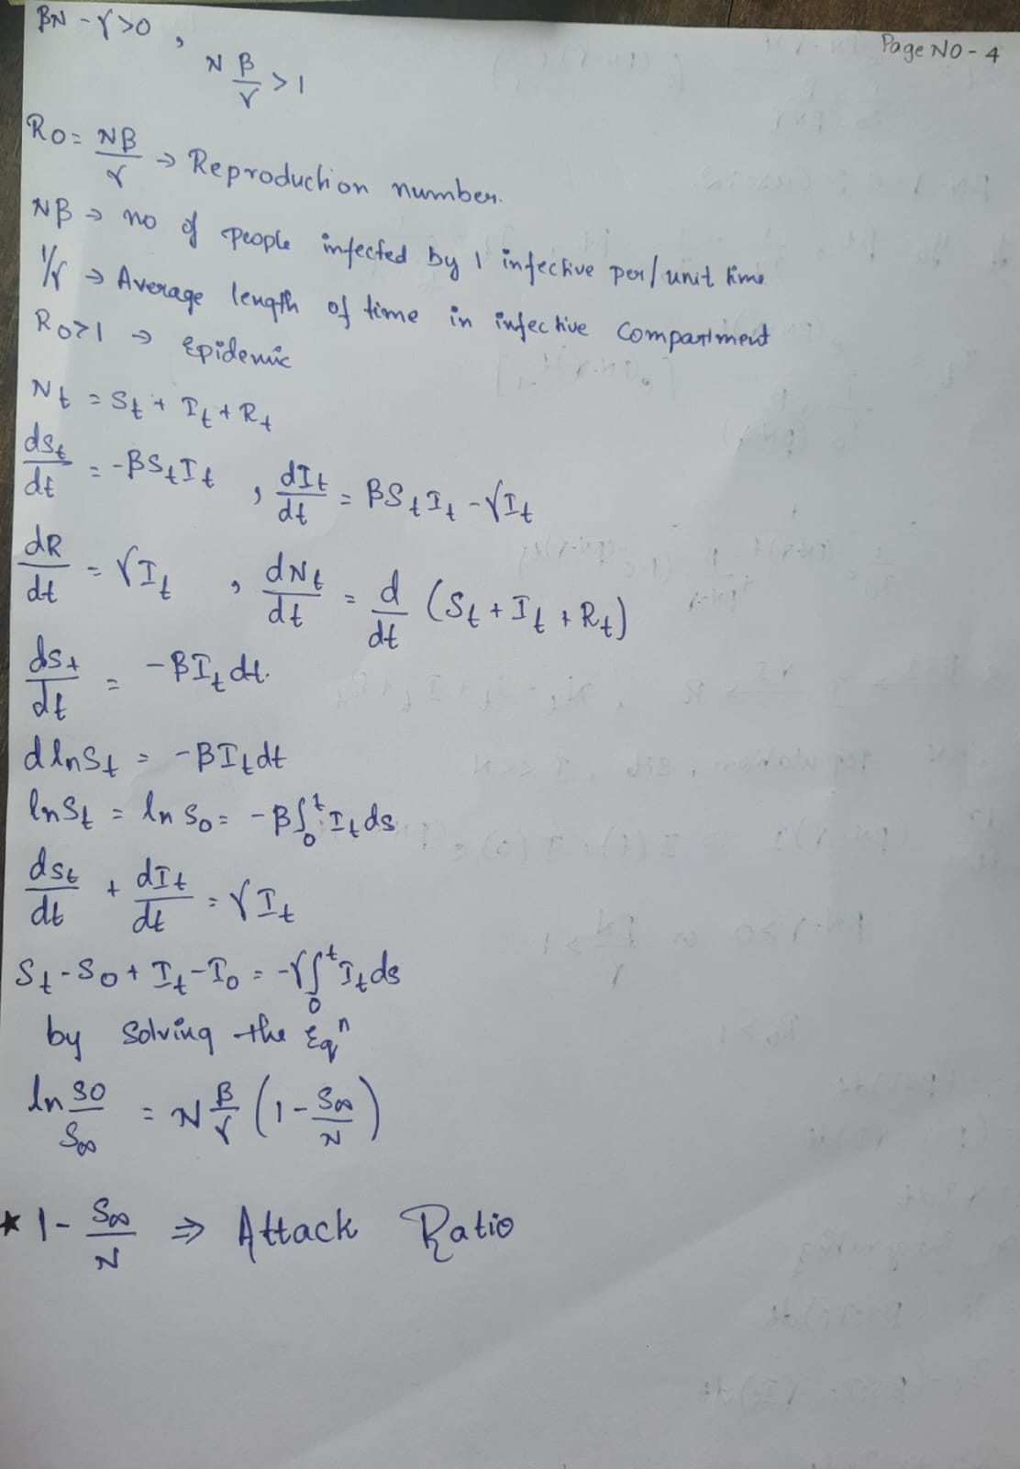

Slide 14
SIR MODEL APPLICATIONS
APPLICATIONS OF SIR MODEL:
Predicting Disease Spread : SIR models can predict how quickly and widely an infectious disease will spread through a population. This helps in anticipating the peak of an outbreak, the potential number of infections, and the overall duration of the epidemic.
Understanding Disease Dynamics: By studying how diseases spread, these model provide insights into factors that influence the speed and scale of transmission, such as population density, movement patterns, and social behaviors.
Informed Decision-Making: Policymakers use epidemic models to make data-driven decisions about implementing or lifting public health measures. This ensures that interventions are timely and proportional to the level of threat.
Resource Allocation: Models can help determine where and when resources (e.g., vaccines, medical staff, hospital beds) should be allocated to maximize their impact.

Slide 15
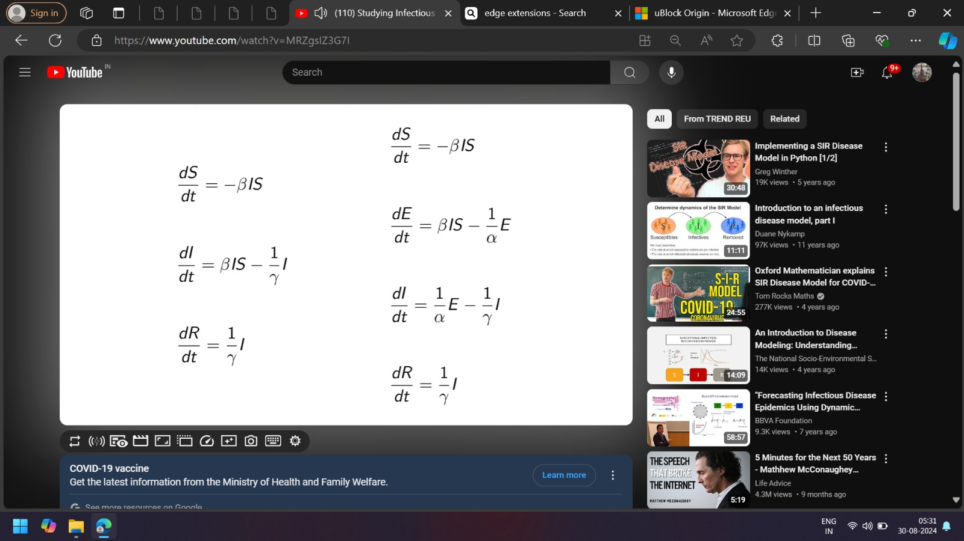
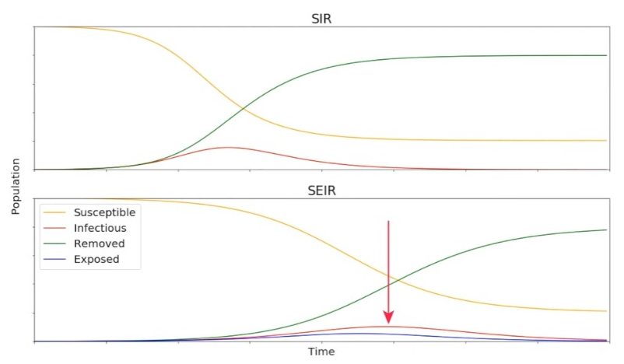
SEIR Model
SIR Variants
(Susceptible-Exposed-Infected-Recovered)
Best For: Diseases with a significant incubation period, where individuals are exposed but not yet infectious.
Strengths: More realistic than the SIR model for diseases like COVID-19, where there's an incubation period.
Limitations: Still assumes homogeneous mixing and does not account for deaths.

Slide 16


SIRD Model
SIR Variants
(Susceptible-Infected-Recovered-Deceased)
Best For: Modeling the impact of a disease where mortality is a significant factor.
Strengths: Accounts for disease-induced mortality, making it more suitable for severe pandemics.
Limitations: Does not account for an incubation period (exposed phase).

Slide 17
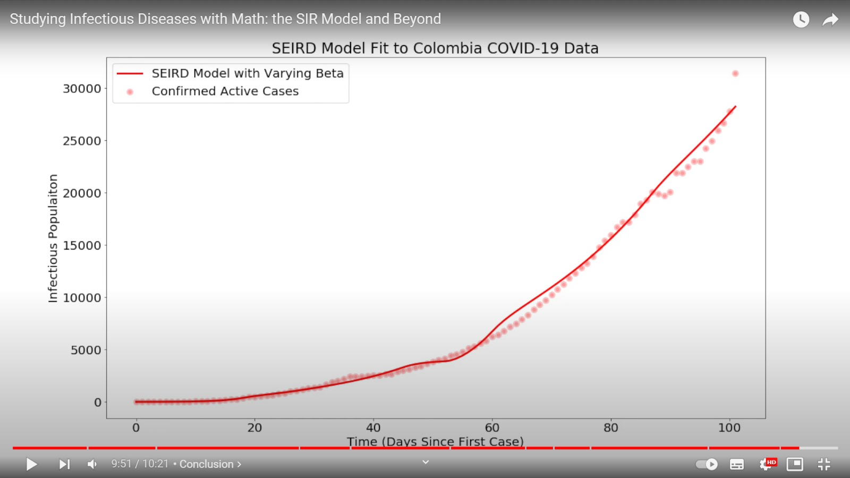
SEIRD Model
SIR Variants
SEIRD Model (Susceptible-Exposed-Infected-Recovered-Deceased)
Best For: Modeling diseases with an incubation period (exposed phase) before symptoms appear, such as COVID-19. This model helps in understanding and predicting the disease spread more comprehensively.
Strengths:
Includes Incubation Period: Adds an "Exposed" category to account for the time individuals spend in the incubation phase before becoming infectious.
Detailed Dynamics: More accurately reflects the progression of diseases with a latent period.
Comprehensive: Captures both the infectious phase and the progression to recovery or death, providing a fuller picture of disease dynamics.
Limitations:
Complexity: More complex than simpler models (like SIR or SIRD) due to the additional exposed state, requiring more parameters and data for accurate calibration.
Data Requirements: Needs detailed information on the incubation period, transition rates between states, and other factors that may not always be available or easy to estimate.

Slide 18
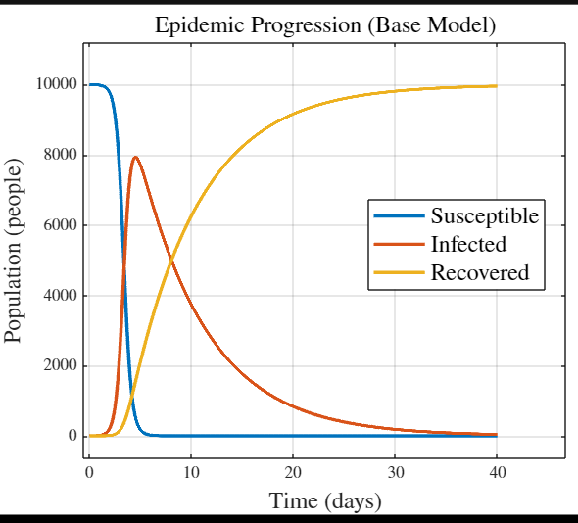
MATLAB Coding
MATLAB Problem Statement
A city initially has 10,000 people, all of whom are susceptible. Then, a single infectious
individual enters the city at t = 0. Use the following estimates for the parameters:
% ME 2004: Epidemic
% In this script, we will solve a system of 1st order ODEs describing the progression of an
% epidemic.
clear; clc; close all;
%% System Parameters
a = 2e-3/7; % Infection rate [1/(person*day)]
r = 0.15; % Recovery rate [1/day]
S0 = 10e3; % Initial number of susceptible people
I0 = 1; % Initial number of infected people
R0 = 0; % Initial number of recovered people
t = 0:0.01:40; % Simulation time vector [days]
%% Calling and Plotting Model
[S,I,R] = epidemic(a,r,S0,I0,R0,t);

Slide 19
Matlab code
figure
plot(t,S,'linewidth',2)
hold on; grid on
plot(t,I,'linewidth',2)
plot(t,R,'linewidth',2)
title('Epidemic Progression (Base Model)','fontsize',14,'Interpreter','latex')
xlabel('Time (days)','fontsize',14,'Interpreter','latex')
ylabel('Population (people)','fontsize',14,'Interpreter','latex')
legend('Susceptible','Infected','Recovered','fontsize',14,'Interpreter','latex')
set(gca,'TickLabelInterpreter','latex')
set(gcf,'Position',[988 196 881 714])
%% Function
function [S,I,R] = epidemic(a,r,S0,I0,R0,t)
dydt = @(t,y) [(-a*y(1)*y(2));
(a*y(1)*y(2) - r*y(2));
(r*y(2))];
[~,y] = ode45(dydt,t,[S0 I0 R0]);
% Parse outputs
S = y(:,1);
I = y(:,2);
R = y(:,3);
end
Code Explanation
% Syntax: [S,I,R] = epidemic(a,r,S0,I0,R0,t)
%
% Inputs:
% a: Infection rate [1/(person*day)] (scalar)
% r: Recovery rate [1/day] (scalar)
% S0: Initial number of susceptible people (scalar)
% I0: Initial number of infected people (scalar)
% R0: Initial number of recovered people (scalar)
% t: Interval of integration. Must have at least 3 elements. (vector)
% Outputs:
% S: Number of susceptible individuals over time (vector)
% I: Number of infected individuals over time (vector)
% R: Number of recovered individuals over time (vector)
% The system of equations is:
% dS/dt = -aSI
% dI/dt = aSI-rI
% dR/dt = rI
%
% Define y = [S dy/dt = [dS/dt = [-aSI = [-a*y(1)*y(2)
% I -----> dI/dt aSI-rI a*y(1)*y(2) - r*y(2)
% R] dR/dt] rI] r*y(2)]

Slide 20
KEY INSIGHTS AND FUTURE SCOPE
Key Insights
Hybrid Approach Overview: Combining SIR models with quantum algorithms represents a cutting-edge strategy to enhance our ability to manage pandemics. By leveraging the predictive power of SIR models and the computational efficiency of quantum algorithms, we can identify optimal strategies for vaccination, testing, and contact tracing.
Optimizing Pandemic Response: Our approach aims to find the most effective measures to minimize long-term damage and accelerate the return to normalcy. The hybrid model enables us to simulate various scenarios with greater precision, helping policymakers make data-driven decisions that balance immediate needs with long-term recovery.
Broader Applications: Beyond pandemics, the solutions generated by this hybrid approach have far-reaching implications. They can be adapted to address other crisis scenarios, such as natural disasters, public health emergencies, and supply chain disruptions. This versatility underscores the potential for these advanced computational methods to improve crisis management across multiple domains.
Future Scope
Moving forward, continued refinement of both SIR models and quantum algorithms will enhance their effectiveness. Integrating real-time data, improving algorithmic efficiency, and expanding the scope of simulation scenarios will be crucial for maximizing the impact of this hybrid approach.

Slide 21
Conclusion
Mathematical models are not just theoretical constructs; they are practical tools that have real-world applications in managing public health. As we continue to face global health challenges, the role of these models in predicting, analyzing, and controlling disease spread will remain crucial. The integration of SIR models with quantum algorithms represents a significant leap forward in optimizing response strategies for complex crises. By harnessing these advanced computational tools, we can improve our preparedness, streamline decision-making, and ultimately build more resilient systems capable of tackling a wide range of challenges.

Slide 22
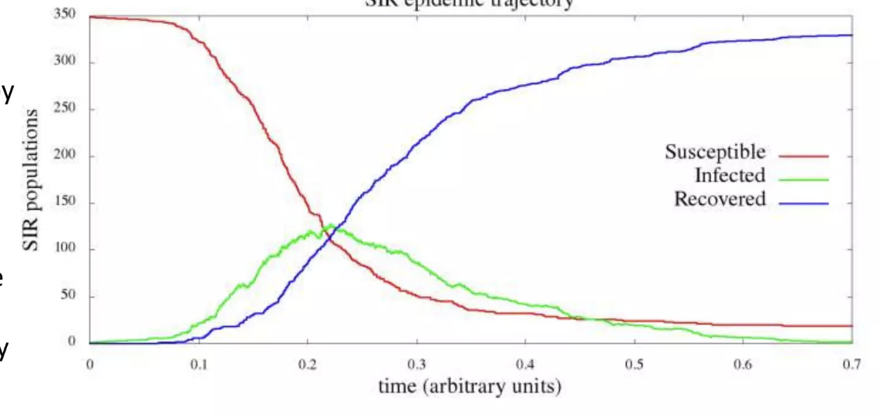
Thank you

